Slide 1
19CSE211 Computer Architecture & Organization
Multi Cycle Data Path Implementation of MIPS Architecture-Part 2

Slide 2
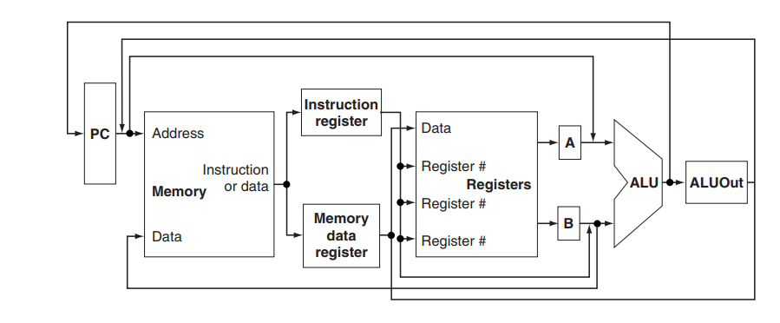
Abstract View of Multicycle Implementation

Slide 3
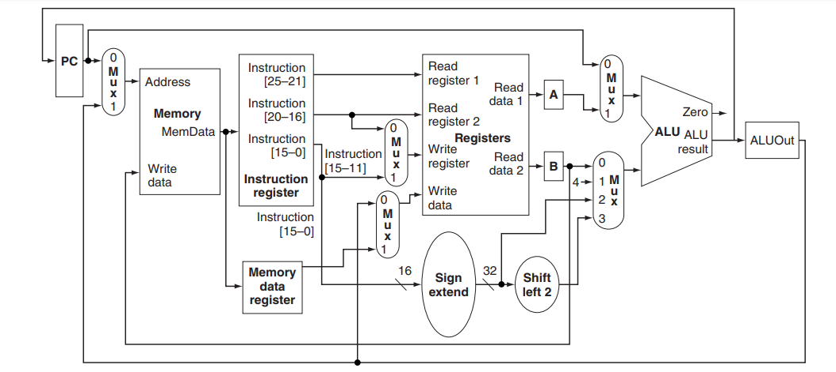

Slide 4
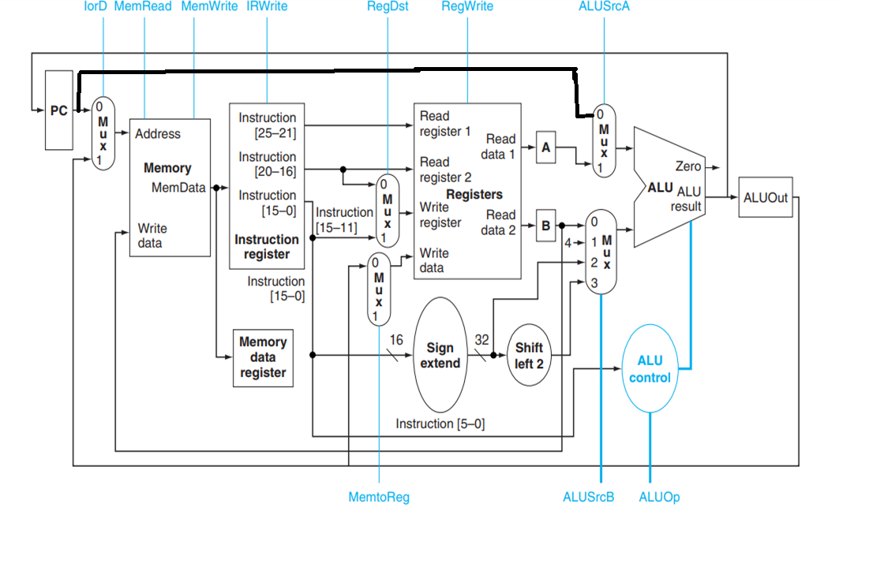

Slide 5
